Slide 1

Bachelor of Technology Algorithmic Trading Using Quantitative Analysis
Major Project
Department of Electronics Engineering
Sardar Patel Institute of Technology
Munshi Nagar, Andheri(W), Mumbai-400058
UNIVERSITY OF MUMBAI
2020-2021

Slide 2
A PRESENTATION ON
Algorithmic Trading Using Quantitative Analysis
Tanishq Salkar 2017110050
Aditya Shinde 2017110055
Neelaya Tamhankar 2017110057
under guidance of
Prof. N.A. Bhagat

Slide 3
Outline
Abstract
Introduction
Motivation
Literature Survey
Research Gap
Problem Statement
Objective
Methodology
Workflow
Functional Block Diagram
Tools
Timeline
References

Slide 4
Abstract
Financial markets are volatile and dynamic in nature, due to which algorithmic trading is becoming popular amongst traders in financial markets.
Algorithmic trading makes use of the speed and data processing advantages that computers have over human traders.
This project involves developing trading strategies based on analysis of market data and using inputs from various technical indicators to perform fully automated trading.

Slide 5
Introduction
Algorithmic trading is a method of executing orders using automated pre-programmed trading instructions accounting for variables such as time, price, and volume.
Today about 75% of the stocks in the U.S are traded by automated trading system.
2% of the firms in the U.S use algorithmic trading but these firms account over 75% of the equity.
60% of U.S equity volume is controlled by machine learning and grid computing.

Slide 6
Motivation
Discipline is often lost due to emotional factors such as fear of taking a loss, or the desire to eke out a little more profit from a trade. Algorithmic trading helps ensure discipline is maintained.
Algorithmic trading can give traders an edge on speed and accuracy.
Algorithmic trading systems are able to generate orders as soon as trade criteria are met. Getting in or out of a trade a few seconds earlier can make a big difference in the trade's outcome. As soon as a position is entered, all other orders are automatically generated, including protective stop losses and profit targets.

Slide 7
Literature Survey
Sr. No. | Title | Methodology | Novelty
1. | Algorithmic Forex Trading using Combination of Numeric Time Series and News Analysis Year: 2018 | This paper proposes a prediction model that combines artificial neural network (Long Short term memory model) for historical analysis and support vector machine for news analysis. | Long Short Term Memory(LSTM) neural network is used to analyze data. Support Vector Machine (SVM) is used to analyze news. Integration of both is done to create trading strategies.
2. | A Novel Algorithmic Trading Approach Based on Reinforcement Learning Year: 2019 | A novel trading algorithmic strategy is proposed that gathers the current market circumstance to agents, allowing it to analyze the situation using it’s own experience and make a decision then in order to decide what the best investment action should be. | Using state-of-the-art techniques based on least-squares temporal difference learning, an algorithmic trading system is built to support the reinforcement learning process.

Slide 8
Literature Survey
3. | Short Term Stock Price Prediction Using Deep Learning Year: 2017 | The paper consists of a comparative study between Long Short Term Memory (LSTM) and Multilayer Perceptron (MLP) in short-term trading time frame. | This project takes into consideration a short-term time frame and the results conclude that MLP are more effective than LSTM in short term analysis.
4. | Neural Network Based Trading Signal Generation in Crypto-Currency Market Year: 2018 | This method makes use of classification and regression machine learning models to generate trading signals. | This project focusses on crypto currency market which is highly volatile in nature.

Slide 9
Literature Survey
5. | Deep Robust Reinforcement Learning for Practical Algorithmic Trading Year: 2019 | Use of stacked denoising autoencoder (SDAE) to denoise observations. Two types of reinforcement learning architecture: DQN and A3C were implemented. | Usage of SDAE for noise removal. Two methods of reinforcement learning was implemented.
6. | Augmented Textual Features-Based Stock Market Prediction Year: 2020 | Sentiment analysis is carried out using two different approaches: Supervised Machine Learning Approach Lexicon/Rule based sentiment extraction | The methodology adopted uses sentiment analysis which is a part of natural language processing (NLP). Using sentiment analysis public tweets are analyzed.

Slide 10
Literature Survey
7. | The Machine Predicted Market Year: 2018 | This paper puts forth various trading processes which can be automized for performing algorithmic trading and talks about the future relevance of algorithmic trading. | This paper gives us an overview of different types of trading strategies namely: Fundamental Analysis, Technical Analysis and Quantitative Analysis.

Slide 11
Literature Survey - Patents
Sr. No. | Title | Methodology | Novelty
1. | A financial transaction method based on a deep reinforcement learning A3C algorithm Year: 2019 | This patent proposes a deep reinforcement learning method to execute financial trading. A simulated trading environment is built and based on that data trading system is developed. | A3C deep reinforcement learning algorithm is used for financial transaction. This system interacts continuously with historical data through trial and error through online learning, dynamically updates the strategic network parameters and evaluation network parameters in the A3C model
2. | Algorithm transaction method based on machine learning Year: 2019 | This patent proposes a machine learning approach to perform algorithmic trading. Based on OHLC data trading strategies are built. | Feature extraction and dataset building is done manually. Machine learning approach is used to develop trading strategies. OHLC parameters are used as features.

Slide 12
Literature Survey - Patents
Sr. No. | Title | Methodology | Novelty
3. | System for Volume-Weighted Average Price trading Year: 2012 | This patent proposes a Volume Weighted Average Price trading methodology. A crossing pool is implemented to trade between financial markets. | The system can employ a crossing pool as a guaranteed VWAP execution technique. A crossing pool is implemented for trading in financial markets. Only one statistical measure is used to make the decision for trading.
4. | Methods, systems, and computer program products for trading financial instruments on an exchange Year: 2009 | This patent proposes a computer based algorithmic trading system. The contingency can be based on a VWAP of the security, a TWAP of the security, a TVOL; of the security as a percentage of total market volume during a specified period or a net asset value (NAV) of the security. | Order matching is done to identify the contingencies of the financial instrument. TWAP, TVOL and NAV are used to to execute trading orders.

Slide 13
Research Gap
Through our literature survey we observed the following limitations in the present system:
The current system perform trading or predictions based on primitive parameters like opening price, closing price, volume of stocks and news. They do not integrate analysis of technical indicators in their trading strategies.
There is a need of a fully automated trading system which requires no human intervention by connecting with online brokers via APIs.

Slide 14
Problem Definition
Trading in financial markets give higher returns if the risk associated is higher. The quantitative analysis of data defines calculated risk in investing. Our aim is to build an algorithmic trading system which requires no human intervention to carry out trading. Using quantitative analysis of data the strategies will get built. Data driven approach is set to execute trading automatically.

Slide 15
Objectives
Use of web scraping to fetch real time data
Trading algorithms based on quantitative analysis of data
Algorithmic trading methodology making use of market defined technical indicators
Coding the key performance indicators (KPIs)
Back testing of the implemented strategy
Online broker integration using APIs
Demo using online brokers like FXCM

Slide 16
Workflow
01
Extracting data of specified duration using web-scraping
Study of technical indicators
02
Performing thorough quantitative analysis of fundamental data
03
Building algorithmic trading strategies
04
Carrying out performance analysis by back testing the strategies
05
Integrating strategies and APIs
06

Slide 17
Functional Block Diagram
Using web scraping extract fundamental stock data
Data Pre-processing and data handling
Incorporating technical indicators and performing quantitative analysis
Data visualization of technical indicators
Demo of algorithmic trading using APIs and demo account
Incorporating strategies and integrating them with APIs
Performance measurement using KPI’s
Backtesting strategies

Slide 18
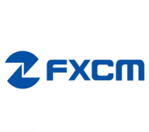
Tools
Python programming language will be used to develop scripts.
IDEs: Jupyter Notebooks OR Spyder
Online brokers for Python APIs and demo account: FXCM

Slide 19
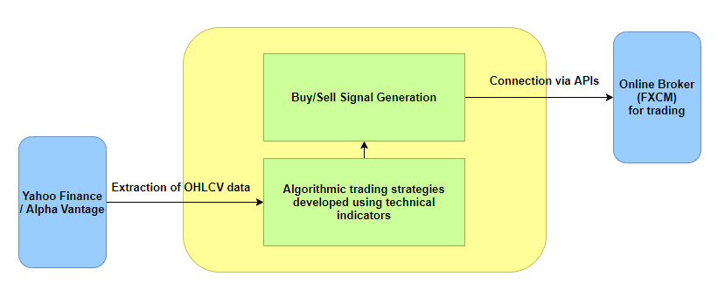
Block Diagram

Slide 20
Our Approach
In order to build our fully automated trading system, we are going to make use of market defined technical indicators:
Moving Average Convergence Divergence (MACD)
Average True Range (ATR) and Bollinger Bands
Relative Strength Index (RSI)
Average Directional Index (ADX)
On-balance Volume (OBV)
Renko

Slide 21
Technical Indicators
Trend indicators tell you which direction the market is moving in, if there is a trend at all. They’re sometimes called oscillators, because they tend to move between high and low values like a wave. Eg. Moving Average Convergence Divergence (MACD)
Momentum indicators tell you how strong the trend is and can also tell you if a reversal is going to occur. They can be useful for picking out price tops and bottoms. Eg. Relative Strength Index (RSI) and Average Directional Index (ADX)
Volume indicators tell you how volume is changing over time.
Volatility indicators tell you how much the price is changing in each period. Eg. Bollinger Bands

Slide 22
MACD
Moving Average Convergence Divergence (MACD) is calculated by subtracting the 26-period exponential moving average (EMA) from the 12-period EMA.
MACD triggers technical signals when it crosses above (to buy) or below (to sell) its signal line (9-period EMA).
The speed of crossovers is also taken as a signal of a market is overbought or oversold.
MACD helps investors understand whether the bullish or bearish movement in the price is strengthening or weakening.

Slide 23
RSI
The relative strength index (RSI) is a popular momentum oscillator developed in 1978.
The RSI provides technical traders signals about bullish and bearish price momentum, and it is often plotted beneath the graph of an asset's price.
An asset is usually considered overbought when the RSI is above 70 and oversold when it is below 30.

Slide 24
Bollinger Bands
Bollinger Bands are a technical analysis tool developed by John Bollinger for generating oversold or overbought signals.
There are three lines that compose Bollinger Bands: A simple moving average (middle band) and an upper and lower band.
The upper and lower bands are typically 2 standard deviations +/- from a 20-day simple moving average, but can be modified.

Slide 25
ATR
Average true range (ATR) is a technical indicator measuring market volatility.
It is typically derived from the 14-day moving average of a series of true range indicators.
It was originally developed for use in commodities markets but has since been applied to all types of securities.

Slide 26
ADX
Designed by Welles Wilder for commodity daily charts, but can be used in other markets or other timeframes.
The price is moving up when +DI is above -DI, and the price is moving down when -DI is above +DI.
Crosses between +DI and -DI are potential trading signals as bears or bulls gain the upper hand.
The trend has strength when ADX is above 25. The trend is weak or the price is trendless when ADX is below 20, according to Wilder.
Non-trending doesn't mean the price isn't moving. It may not be, but the price could also be making a trend change or is too volatile for a clear direction to be present.

Slide 27
Renko Charts
Renko charts are composed of bricks that are created at 45-degree angles to one another. Consecutive bricks do not occur beside each other.
A brick can be any price size, such a $0.10, $0.50, $5, and so on. This is called the box size. Box size can also be based on the Average True Range (ATR).
Renko charts have a time axis, but the time scale is not fixed. Some bricks may take longer to form than others, depending on how long it takes the price to move the required box size.
Renko charts filter out noise and help traders to more clearly see the trend, since all movements that are smaller than the box size are filtered out.
Renko charts typically only use closing prices based on the chart time frame chosen. For example, if using a weekly time frame, then weekly closing prices will be used to construct the bricks.

Slide 28
CAGR
CAGR is one of the most accurate ways to calculate and determine returns for anything that can rise or fall in value over time.
Investors can compare the CAGR of two alternatives in order to evaluate how well one stock performed against other stocks in a peer group or against a market index.
CAGR does not reflect investment risk.
Volatility
Volatility represents how large an asset's prices swing around the mean price - it is a statistical measure of its dispersion of returns.
There are several ways to measure volatility, including beta coefficients, option pricing models, and standard deviations of returns.
Volatile assets are often considered riskier than less volatile assets because the price is expected to be less predictable.
Volatility is an important variable for calculating options prices.

Slide 29
Sharpe Ratio
The Sharpe ratio adjusts a portfolio’s past performance—or expected future performance—for the excess risk that was taken by the investor.
A high Sharpe ratio is good when compared to similar portfolios or funds with lower returns.
The Sharpe ratio has several weaknesses, including an assumption that investment returns are normally distributed.
Sortino Ratio
The Sortino ratio differs from the Sharpe ratio in that it only considers the standard deviation of the downside risk, rather than that of the entire (upside + downside) risk.
Because the Sortino ratio focuses only on the negative deviation of a portfolio's returns from the mean, it is thought to give a better view of a portfolio's risk-adjusted performance since positive volatility is a benefit.
The Sortino ratio is a useful way for investors, analysts, and portfolio managers to evaluate an investment's return for a given level of bad risk.

Slide 30
Calmar Ratio
The Calmar ratio is a measure of risk-adjusted returns for investment funds, created by fund manager Terry Young in 1991.
The Calmar ratio uses a fund’s maximum drawdown as its sole measure of risk, which makes it unique. This could also be considered one of its weaknesses.
Maximum Drawdown
Maximum drawdown (MDD) is a measure of an asset's largest price drop from a peak to a trough.
Maximum drawdown is considered to be an indicator of downside risk, with large MDDs suggesting that down movements could be volatile.
While MDD measures the largest loss, it does not account for the frequency of losses, not the size of any gains.

Slide 31
Strategy 1: MACD + RSI
Moving Average Convergence Divergence (MACD): Trend Indicator
Relative Strength Index (RSI): Momentum Indicator
Buy Signal:
MACD value greater than signal value AND
RSI > 30 AND
RSI[current] > RSI [previous]
Exit Signal:
MACD value less than signal value AND slope(MACD) < slope(signal).
OR
2. RSI >70

Slide 32
Strategy 2: MACD + Renko
Buy Signal:
Renko > 2 AND
MACD value greater than signal value AND
slope(MACD) > slope(signal)
Exit Signal:
MACD value less than signal value AND
slope(MACD) < slope(signal).

Slide 33

Strategy 3: MACD + OBV
Moving Average Convergence Divergence (MACD): Trend Indicator
On Balance Volume (OBV): Momentum Indicator
Buy Signal:
MACD value greater than signal value AND
slope(MACD) > slope(signal) AND
Last 5 consecutive points OBV slope > ${30}^{0}$
Exit Signal:
MACD value less than signal value AND
slope(MACD) < slope(signal).

Slide 34

Strategy 4: OBV+ Renko
Buy Signal:
Renko bar value > 2 AND
Last 5 consecutive points OBV slope > ${30}^{0}$
Exit Signal :
1. Renko bar value < 2

Slide 35
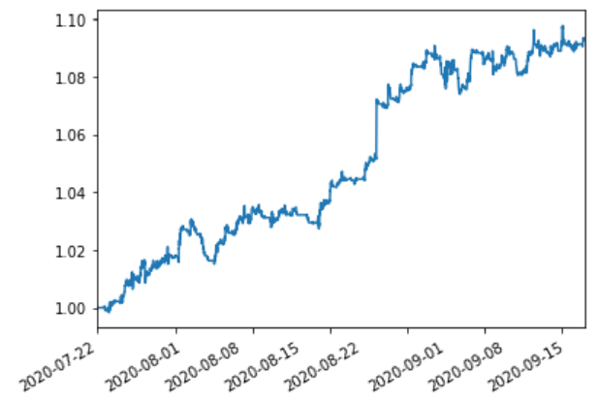
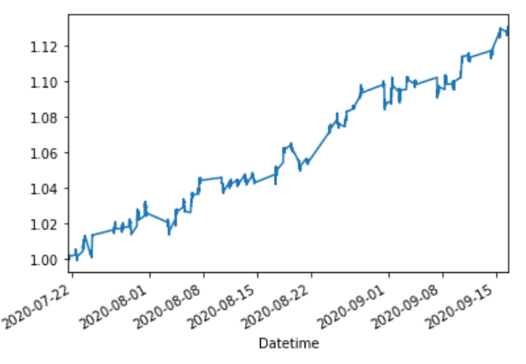
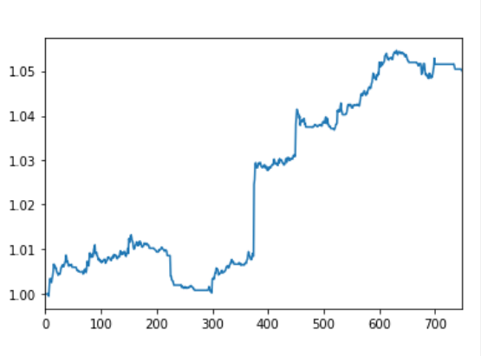
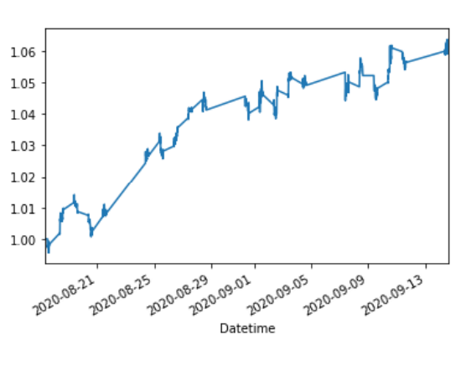
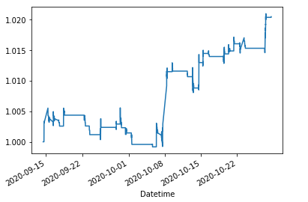
Results
Returns on MACD and Renko strategy
Returns on Renko and OBV strategy
Returns on MACD and RSI strategy
Returns on MACD and OBV strategy
Returns on Resistance Breakout strategy

Slide 36
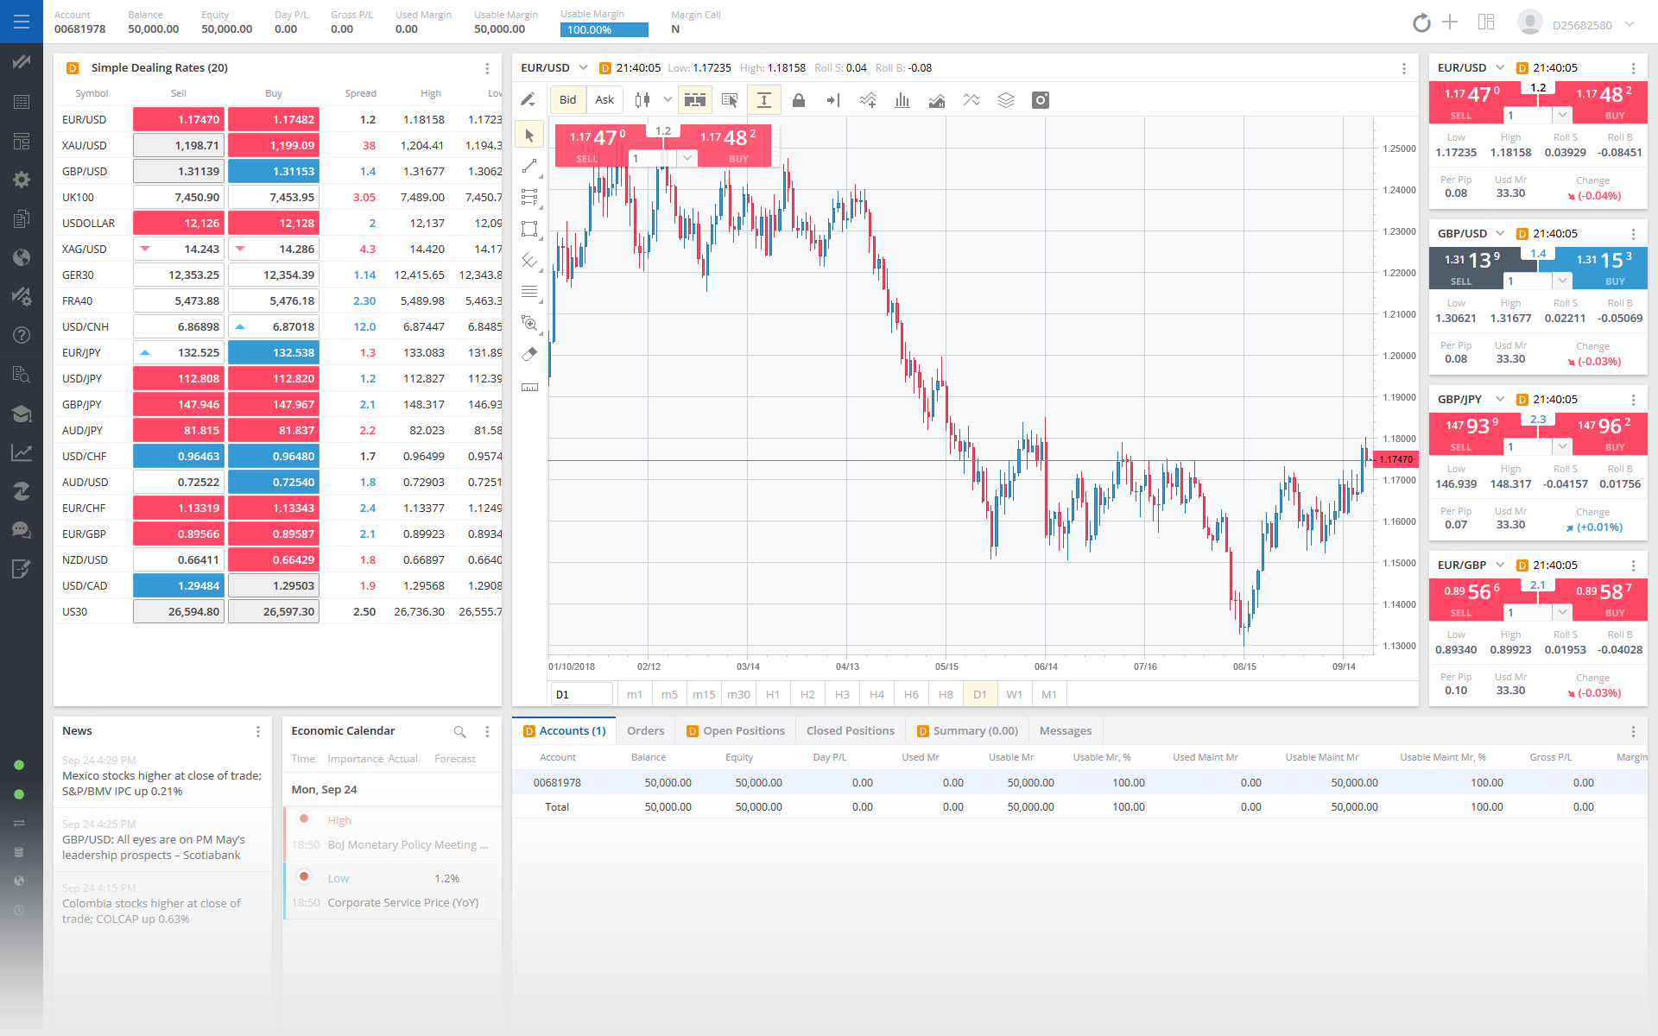
FXCM DEMO ACCOUNT

Slide 37
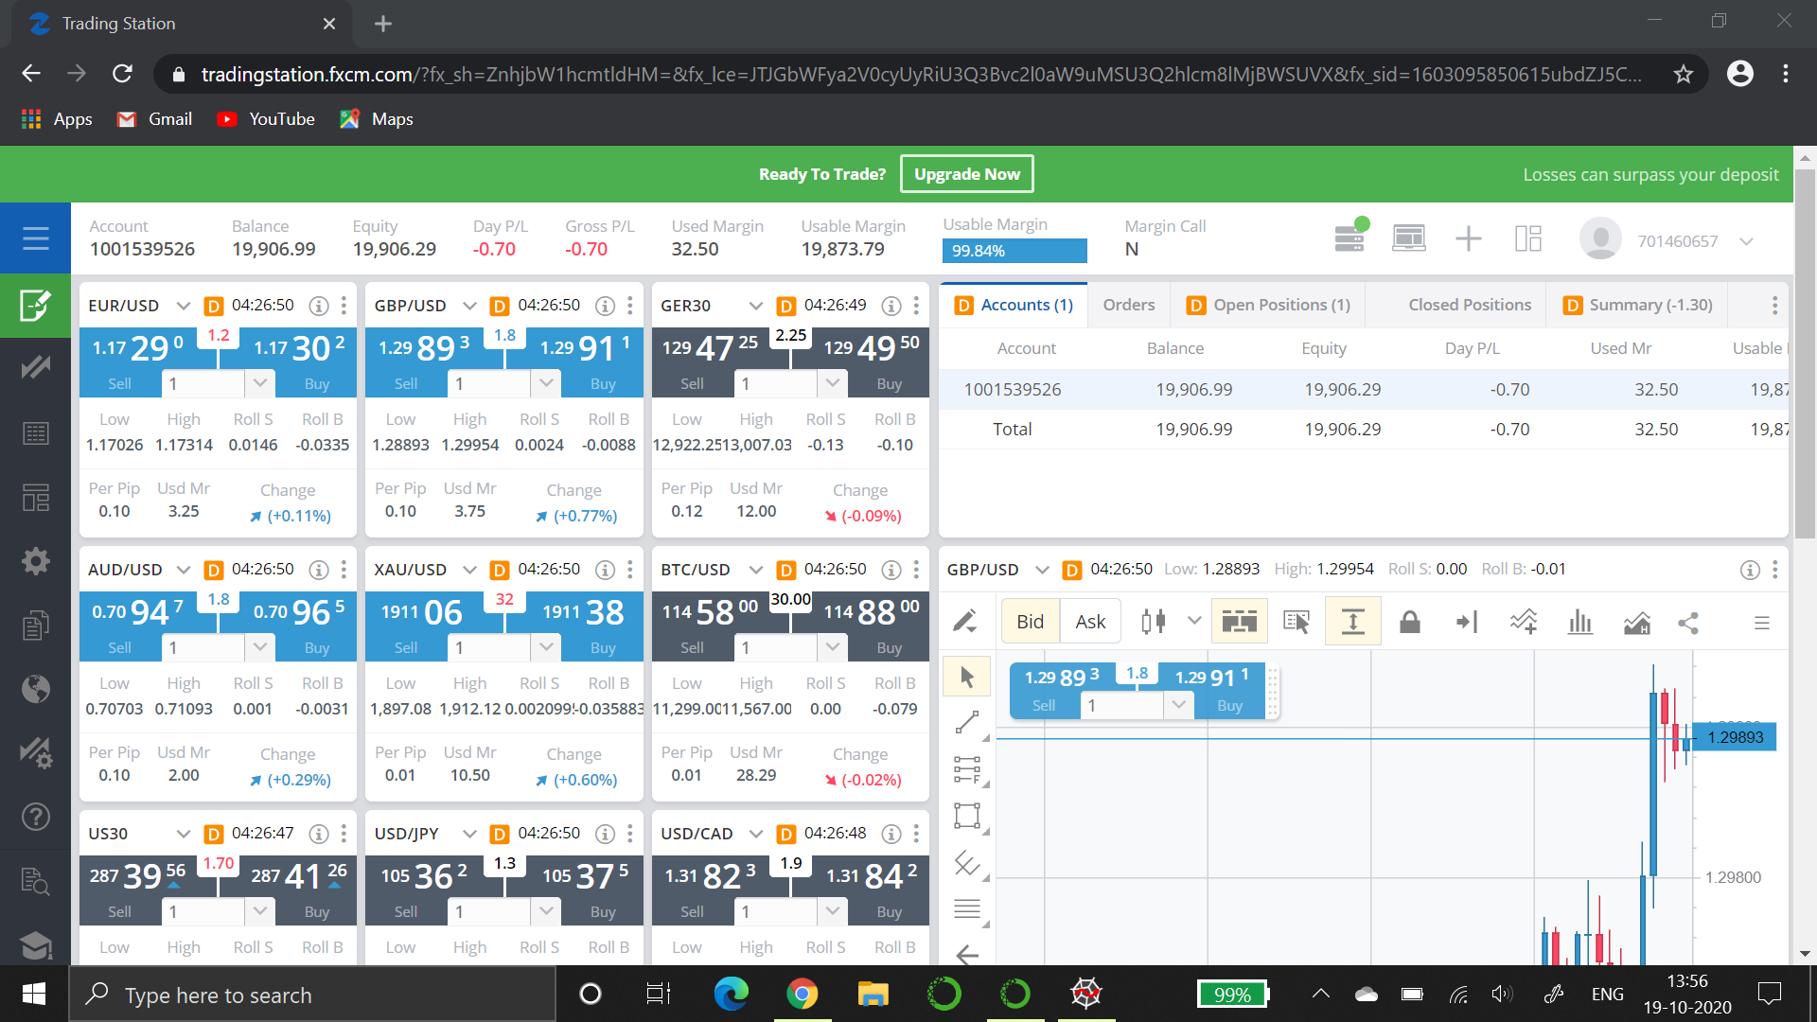
Results

Slide 38
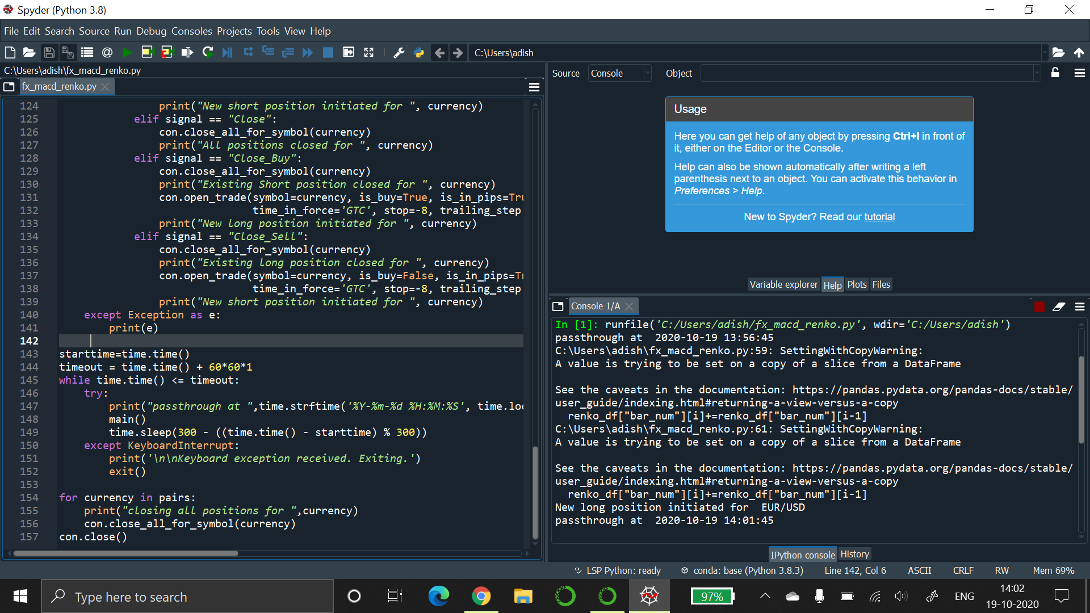
Results

Slide 39
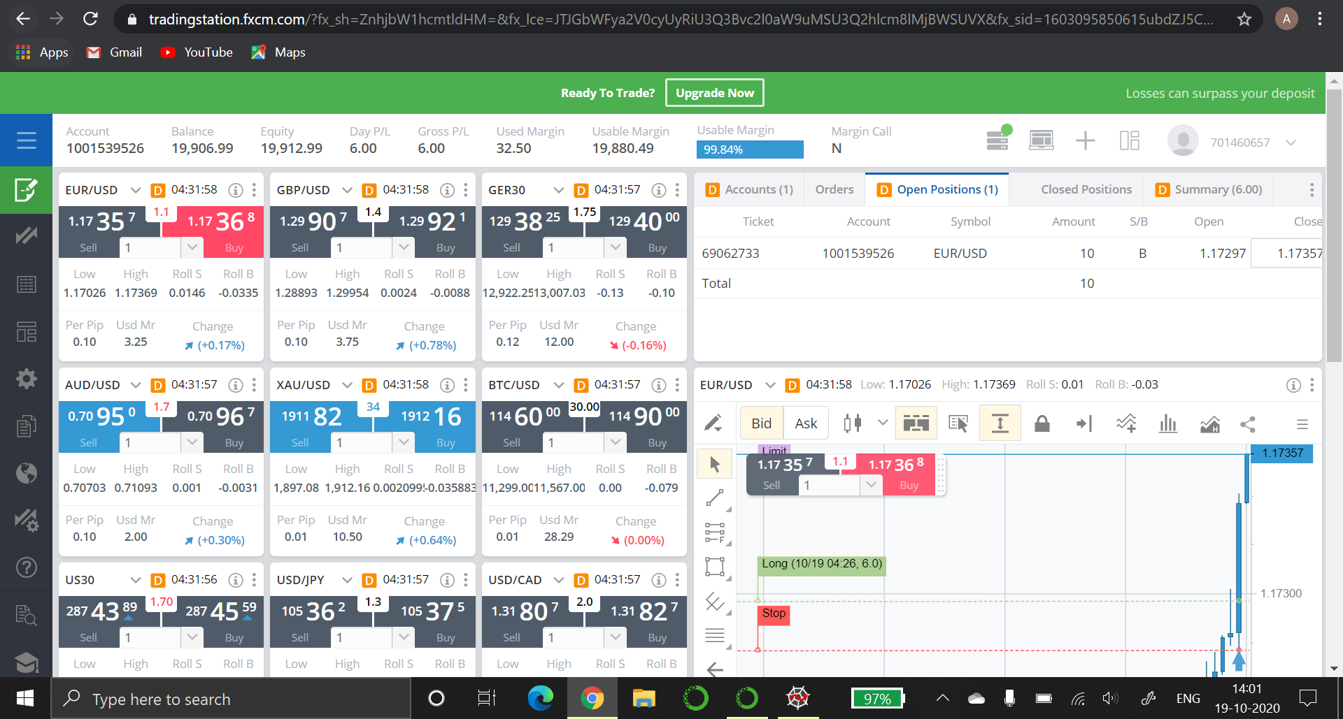
Results

Slide 40
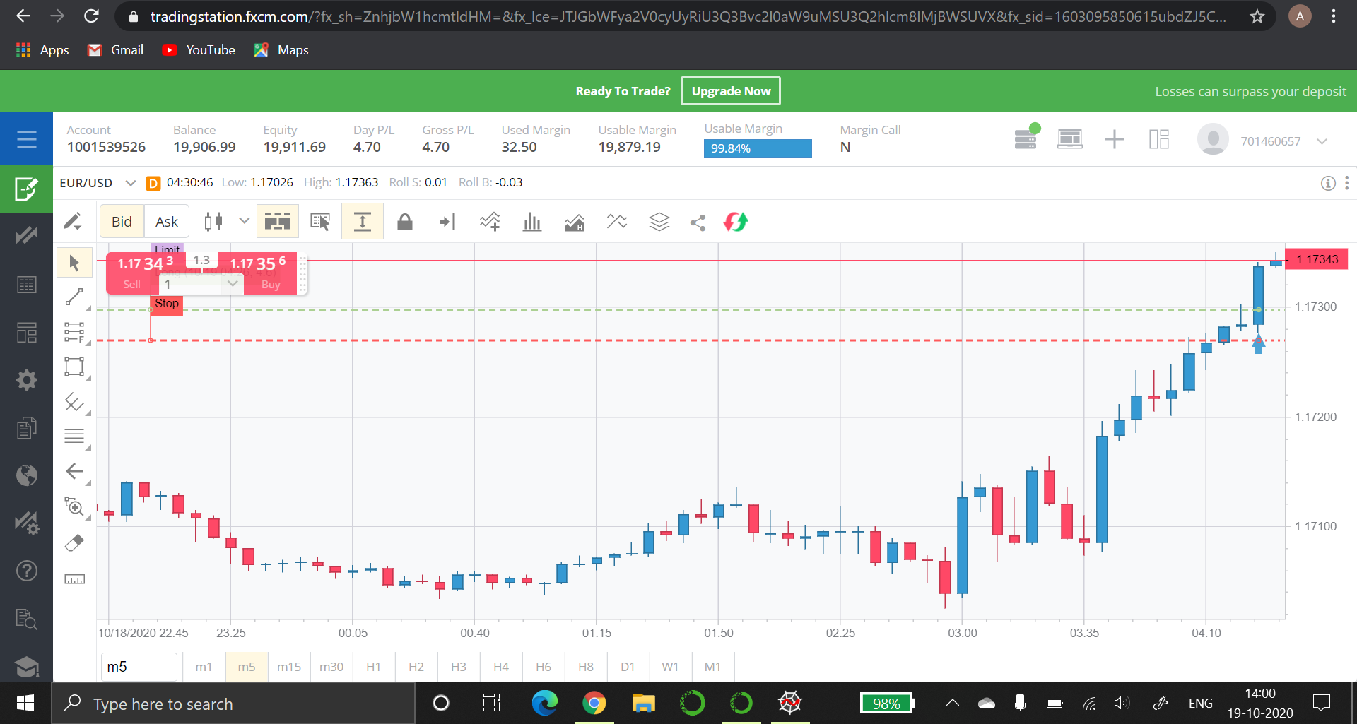
Results

Slide 41
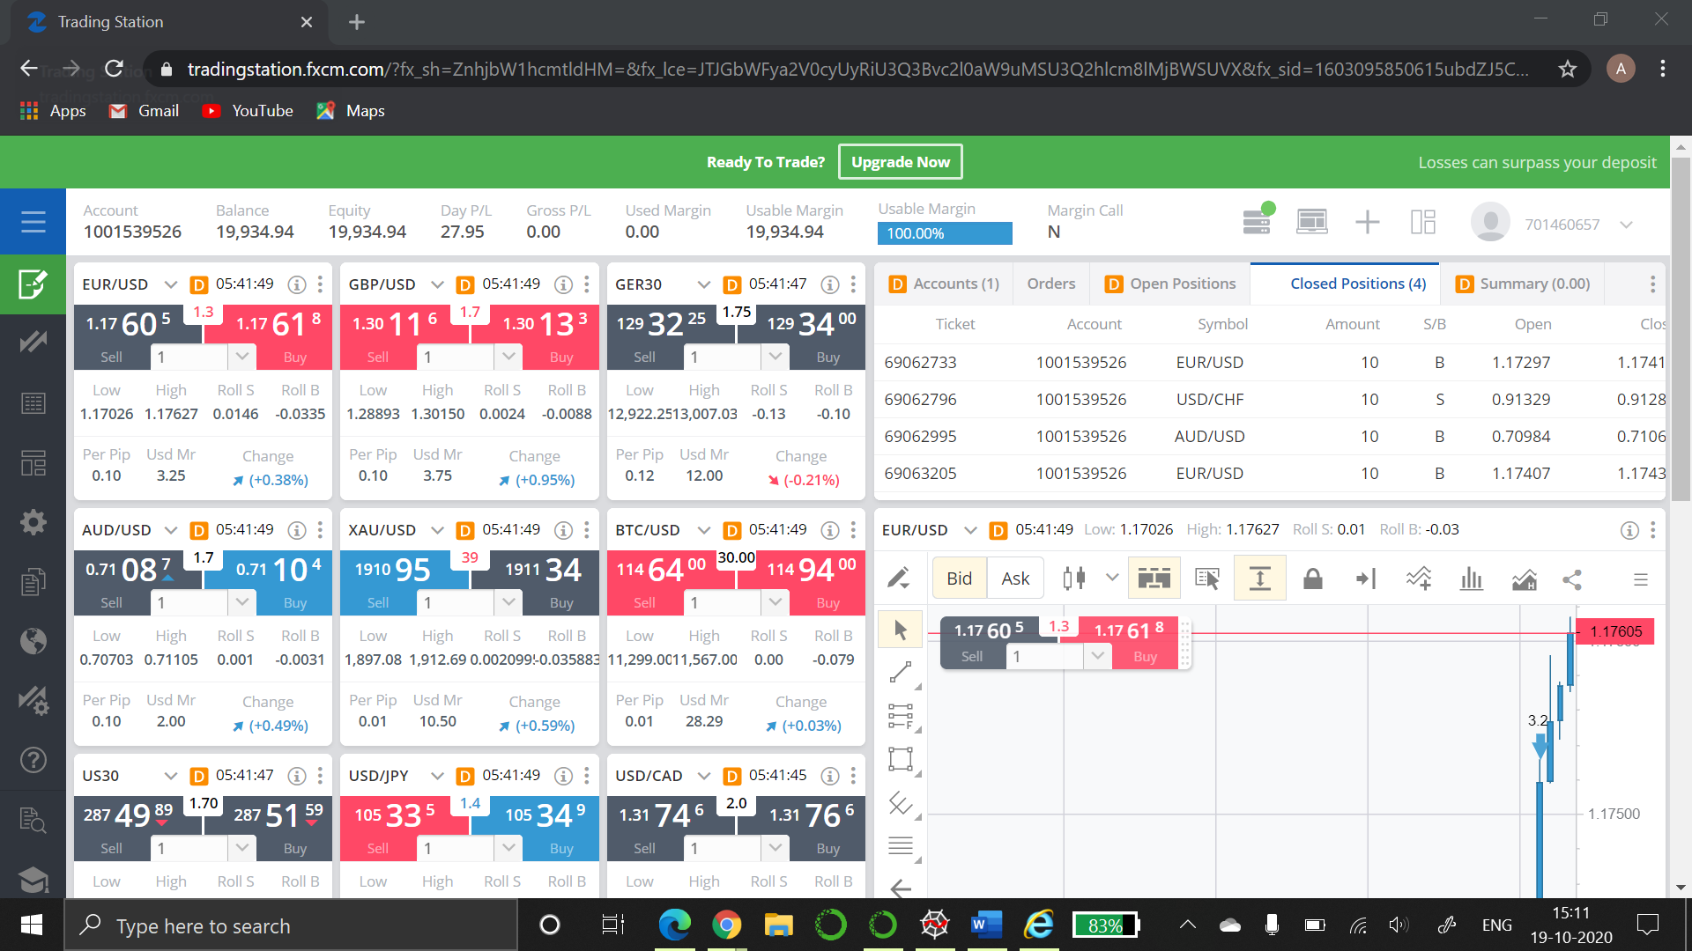
Results

Slide 42
Timeline
Phase 2
Completion of incorporation of technical indicators and starting quantitative analysis.
Phase 4
Demo of algorithmic trading using APIs and demo account.
Title Finalization
Finalized the title based on proposed problem
01
02
03
04
05
Phase 1
Detailed literature survey, identification of problem statement and defining objectives.
Phase 3
Completion of all steps with back testing of strategies.

Slide 43
References
V. Patil, N. Somani, A. Tadvi and V. Attar, "Algorithmic Forex Trading using Combination of Numeric Time Series and News Analysis," 2018 4th International Conference for Convergence in Technology (I2CT), Mangalore, India, 2018, pp. 1-5, doi: 10.1109/I2CT42659.2018.9058285.
K. Khare, O. Darekar, P. Gupta and V. Z. Attar, "Short term stock price prediction using deep learning," 2017 2nd IEEE International Conference on Recent Trends in Electronics, Information & Communication Technology (RTEICT), Bangalore, 2017, pp. 482-486, doi: 10.1109/RTEICT.2017.8256643.
S. Bouktif, A. Fiaz and M. Awad, "Augmented Textual Features-Based Stock Market Prediction," in IEEE Access, vol. 8, pp. 40269-40282, 2020, doi: 10.1109/ACCESS.2020.2976725.
L. Xucheng and P. Zhihao, "A Novel Algorithmic Trading Approach Based on Reinforcement Learning," 2019 11th International Conference on Measuring Technology and Mechatronics Automation (ICMTMA), Qiqihar, China, 2019, pp. 394-398, doi: 10.1109/ICMTMA.2019.00093.

Slide 44
References
Y. Li, W. Zheng and Z. Zheng, "Deep Robust Reinforcement Learning for Practical Algorithmic Trading," in IEEE Access, vol. 7, pp. 108014-108022, 2019, doi: 10.1109/ACCESS.2019.2932789.
A. Özdemir and S. Bogosyan, "Neural Network based Trading Signal Generation in Cypto-Currency Markets," 2018 International Conference on Artificial Intelligence and Data Processing (IDAP), Malatya, Turkey, 2018, pp. 1-4, doi: 10.1109/IDAP.2018.8620889.
S. Taneja, D. Garg, M. V. Tarun Kumar and T. Choudhury, "The Machine Predicted Market," 2018 International Conference on Computational Techniques, Electronics and Mechanical Systems (CTEMS), Belgaum, India, 2018, pp. 256-260, doi: 10.1109/CTEMS.2018.8769306.
R. Sahni, "Analysis of Stock Market Behaviour by Applying Chaos Theory," 2018 9th International Conference on Computing, Communication and Networking Technologies (ICCCNT), Bangalore, 2018, pp. 1-4, doi: 10.1109/ICCCNT.2018.8494103.

Slide 45
References
https://en.wikipedia.org/wiki/Algorithmic_trading
https://towardsdatascience.com
https://patents.google.com/patent
https://worldwide.espacenet.com/patent

Slide 46
Thank You!

